Slide 1
Topic: Fractions
EQ: What is the written for adding and subtracting fractions?

Slide 2
Often drawing pictures of fractions can take too much time, and mentally adding them can be too difficult.
We are going to use the pictures method to teach you how to add fractions using numbers

Slide 3
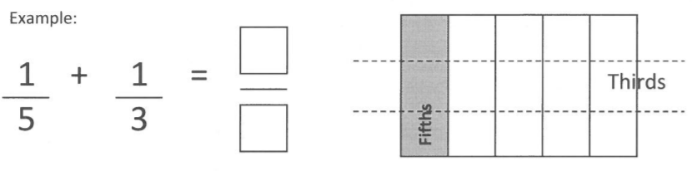
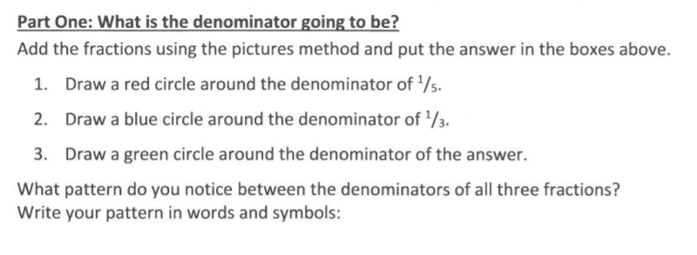
Multiplying the denominators in the question gives the denominator in the answer
5 x 3 = 15
five multiplied by three equals fifteen

Slide 4
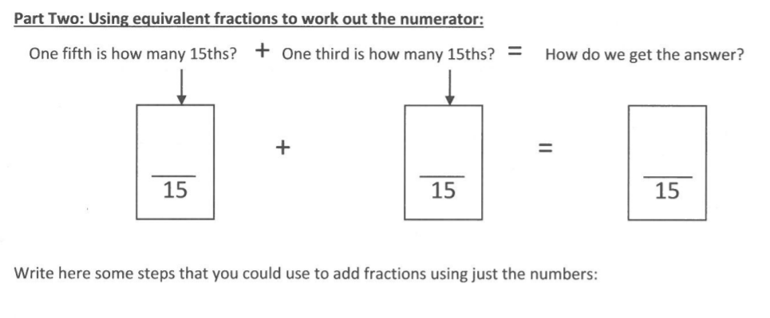
Students to write this
1. If the denominators are not the same, then you have to use equivalent fractions which do have a common denominator . To do this, you need to find the least common multiple (LCM) of the two denominators.
2. To add fractions with unlike denominators, rename the fractions with a common denominator. Then add.

Slide 5
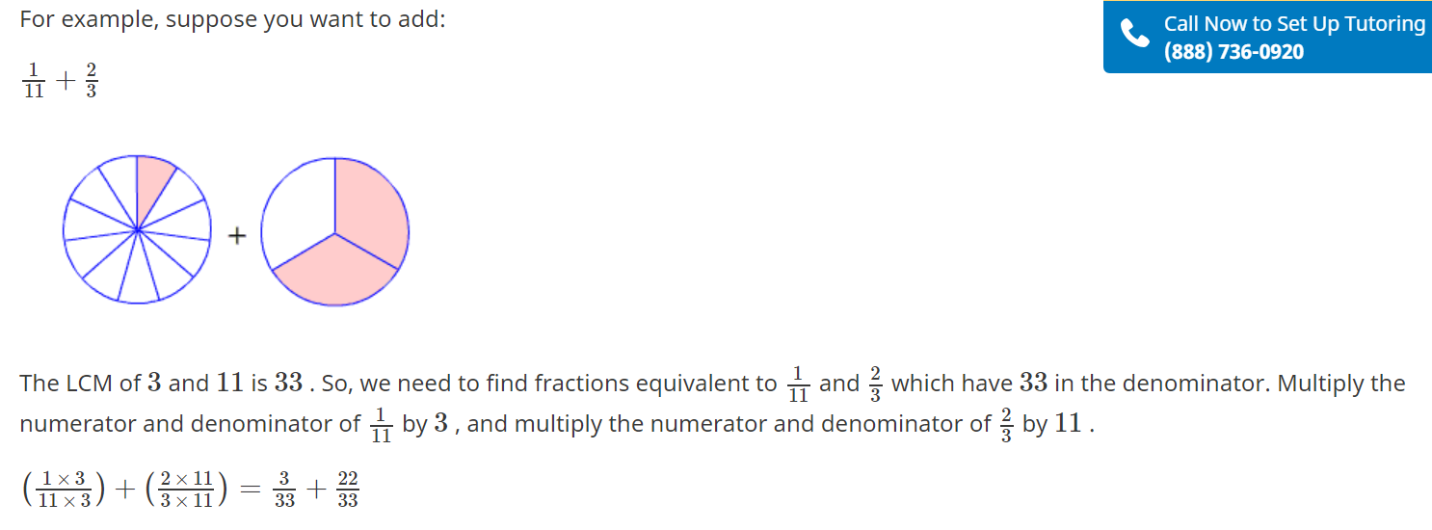
Teacher notes only

Slide 6
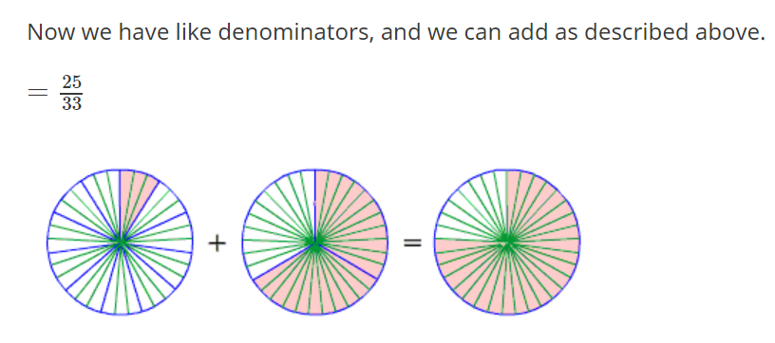
Teacher notes only

Slide 7
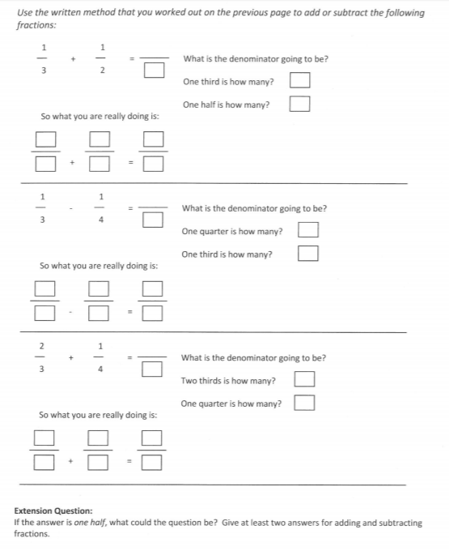
Hand out to students

